Slide 1

SNAKE GAME
Members :-​
138 - Tridha Das​
139 - Subham Bose​
140 - Trishita Mukherjee​
141 - Soumyadeep Dey​
142 - Somsubhra Kar ​
143 - Sayan Kumar Ghosh​

Slide 2

ACKNOWLEDGEMENT
Presentation, inspiration and motivation have
always played a key role in the success of any
venture​. We express our sincere thanks to
Prof (Dr.) Santanu Kr Sen, Principal, GNIT.​ We
pay our deep sense of gratitude to Dr. Rupak
Chakraborty and our guide whose valuable
guidance and kind supervision given to us
throughout the course which shaped the present
work as it shows, and to encourage us to the
highest peak and to provide us the opportunity to
prepare the project.​ Last but not the least, our
parents are also an important inspiration for us.
So, with due regards, we express our gratitude to them​.
​

Slide 3

Objectives​
Introduction
Flow Diagram
Working Mechanism​
Outcome​
Conclusion ​
Reference​
CONTENTS

Slide 4

OBJECTIVES
To learn and implement the various topics learnt in C. ​
To use them to solve problems in real life.​
To gain experience of building a game using programming language C.​
To build teamwork and communication skills​

Slide 5

INTRODUCTION
The project is called the "Snake Game" which is the classic game, where we can control the
movements of a snake's head using some keys, and the target is to eat as many fruits as possible,
it's an arcade game, so the aim is to get our personal highest score or to beat other people's high
scores. The challenge however is that the snake's head can neither hit the boundary walls not its
own tail.​
We have made the game in C language using modular programming and creating several functions,
each responsible for a specific task. Like this it will be more maintain a bleand readable, the bugs
can also be fixed and spotted easily. We have incorporated data structures like 1 dimensional arrays and several
concepts like nested looping, rand() to randomize the spawning coordinate of the fruit, getch() to get input
from the user and based on that deciding the direction of the snakes head, a algorithms to increase the length
of the snake and store the new coordinates by shifting the older coordinates in the array through swapping
from left to right(explained in detail later).After the game is over, one can press the 'y' key and it will show the
score the person has scored. We also tested the game vigorously and it's completely functional with no bugs.​

Slide 6
FLOW DIAGRAM
Create draw area on screen
Check for user input
If “Y”, gameover else keep the food at old position​
Increase snake length by 1 after a fruit is eaten​
Check if head and wall position is same
Check if the head touched the tail​
If Yes, display game over and start again​
Start

Slide 7
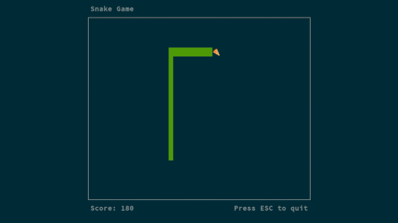
WORKING MECHANISM
Build a boundary within which the game will be played
The snake is represented with a 0(zero) symbol.
The fruit is represented with an ‘F’ symbol.
The snake can move in any direction according to the user with the help of the keyboard (W, A, S, D keys).
When the snake eats a fruit the score will increase by 10 points.
Whenever the snake will touch the boundary or its own tail the game is over.
Generate a new food randomly.

Slide 8

INITIALIZATION
First of all we declare and initialize the global variables.​
height - height of the boundary wall​
width - width of the boundary wall​
gameover - denotes if the game is going on or not.​
x,y - coordinates of the snake's head​
fruitx, fruity - coordinates of the fruit ​
score - total points the player has scored, 10 points for eating each fruit.​
flag - represents the current direction of the snakes head.​

Slide 9

Declaring of 'ch' variable
Declare and initialize counttail to 0 .
Call the setup( ) function.
Start an infinite loop as '1' as condition which will always stay true
Call draw( ) →input( ) →logic( ).
If the value of 'gameover' variable becomes 1 we break the loop using the break statement.
Take input ch using getch( ).
Check if equal to either 'y' or 'Y' ,if condition is true, print "GAME OVER" and the score.
Declaring of 'ch' variable
Declare and initialize counttail to 0 .
Call the setup( ) function.
Start an infinite loop as '1' as condition which will always stay true
Call draw( ) →input( ) →logic( ).
If the value of 'gameover' variable becomes 1 we break the loop using the break statement.
Take input ch using getch( ).
Check if equal to either 'y' or 'Y' ,if condition is true, print "GAME OVER" and the score.
main( )

Slide 10

Initialize gameover==0.
Initial coordinates of the snake are kept width/2 and height/2 for x and y, respectively.
Initialize the coordinates of the fruit or fruitx coordinate using rand()%39.
In case the food comes at zero value, use 'goto' statement to find another random value of fruitx (non zero).
Initialize gameover==0.
Initial coordinates of the snake are kept width/2 and height/2 for x and y, respectively.
Initialize the coordinates of the fruit or fruitx coordinate using rand()%39.
In case the food comes at zero value, use 'goto' statement to find another random value of fruitx (non zero).
setup( )

Slide 11

draw( )
Initialize i and j to use in the nested for loop.
Clear the screen using system("cls").
Print the entire play area i.e a rectangle using nested loop, the outer loop is responsible for the number of rows and the inner row is responsible for the number of columns.
Inside the nested loop several conditions are given, according to which the snake's head, snake's tail, fruit, boundary wall and empty spaces will be printed
Initialize i and j to use in the nested for loop.
Clear the screen using system("cls").
Print the entire play area i.e a rectangle using nested loop, the outer loop is responsible for the number of rows and the inner row is responsible for the number of columns.
Inside the nested loop several conditions are given, according to which the snake's head, snake's tail, fruit, boundary wall and empty spaces will be printed.
New line is printed.

Slide 12

input( )
Create an 'if' conditional statement, use the keyboard hit function to check for user input from the keyboard. If a key is pressed, kbhit() returns true value, else returns false.​
Switch case used to convert the value from the getch() to a flag(a variable).​
The following keys were used as input- 'w', 's', 'a', 'd’.​
For case 'a', 1 is stored in flag, ​
For case 'd', 2 is stored in flag,​
For case 'w', 3 is stored in flag,​
For case 's', 4 is stored in flag.
For last case, when 'x' is pressed, it will trigger game over event.​
Create an 'if' conditional statement,use the keyboard hit function to check for user input from the keyboard. If a key is pressed, kbhit() returns true value, else returns false.​
Switch case used to convert the value from the getch() to a flag(a variable).​
The following keys were used as input- 'w', 's', 'a', 'd’.​
For last case, when 'x' is pressed, it will trigger game over event.​

Slide 13

logic( )
Implement an algorithm to update the coordinates of the snake’s tail.
Whenever a snake moves, its head have new values and the first index of the tail array gets the coordinates of the previous head, now the first indexes in the tail array is updated with the previous 0th index, and so on.
Use the switch case statements in which we take flag and the snake moves accordingly to the given flag value.
specify the conditions to end the game or change the value of 'gameover' to 1 which will end the game loop in main.
The first condition is if the snake's head touches the boundary wall and the second condition is if the snake's head has hit the snake's tail.
If a fruit is found, new randomized coordinates of the fruit generates.
Score increased by 10 points and length of the snake is also increased by 1.
Implement an algorithm to update the coordinates of the snake’s tail.
Whenever a snake moves, its head have new values and the first index of the tail array gets the coordinates of the previous head, now the first indexes in the tail array is updated with the previous 0th index, and so on.
Use the switch case statements in which we take flag and the snake moves accordingly to the given flag value.
specify the conditions to end the game or change the value of 'gameover' to 1 which will end the game loop in main.
The first condition is if the snake's head touches the boundary wall and the second condition is if the snake's head has hit the snake's tail.
If a fruit is found, new randomized coordinates of the fruit generates.
Score increased by 10 points and length of the snake is also increased by 1.

Slide 14
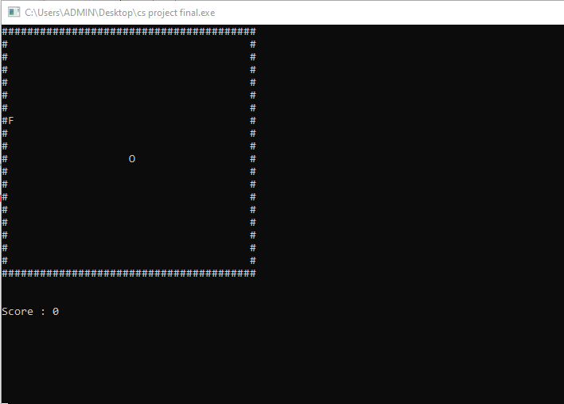
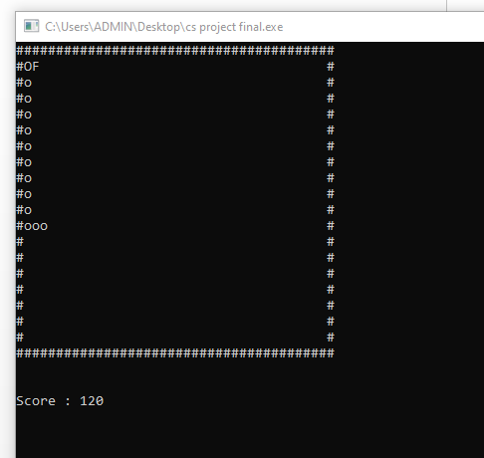
OUTCOME
Start game (score 0)
Game over (wall hit/body hit)

Slide 15

CONCLUSION
Through this project we have learnt to implement the C programming language​ concepts and data structures
and create a full fledged game.​We have also incorporated several concepts like nested loops, functional
programming, rand( ), getch( ) and kbhit( ) functions, goto statements, and several other things that we didn't get
a chance to implement and piece together to create a complete functional project. Other than programming skills
we also learned team work and cooperation, each of us contributed to the code and maintained the code on
github. We also tested the code vigorously so that we didn't turn a blind eye to any corner case. Hence due to
teamwork, cooperation, and consistent efforts from everybody we managed to complete this project successfully.​
Through this project we have learnt to implement the C programming language​ concepts and data structures
and create a full fledged game.​We have also incorporated several concepts like nested loops, functional
programming, rand( ), getch( ) and kbhit( ) functions, goto statements, and several other things that we didn't get
a chance to implement and piece together to create a complete functional project. Other than programming skills
we also learned team work and cooperation, each of us contributed to the code and maintained the code on
github. We also tested the code vigorously so that we didn't turn a blind eye to any corner case. Hence due to
teamwork, cooperation, and consistent efforts from everybody we managed to complete this project successfully.​
​
​
​
​

Slide 16


REFERENCES
The following sources were referenced while making this project.​
https://www.geeksforgeeks.org/
https://www.youtube.com/watch?v=ON5ODiA-AQE&pp=sAQA

Slide 17
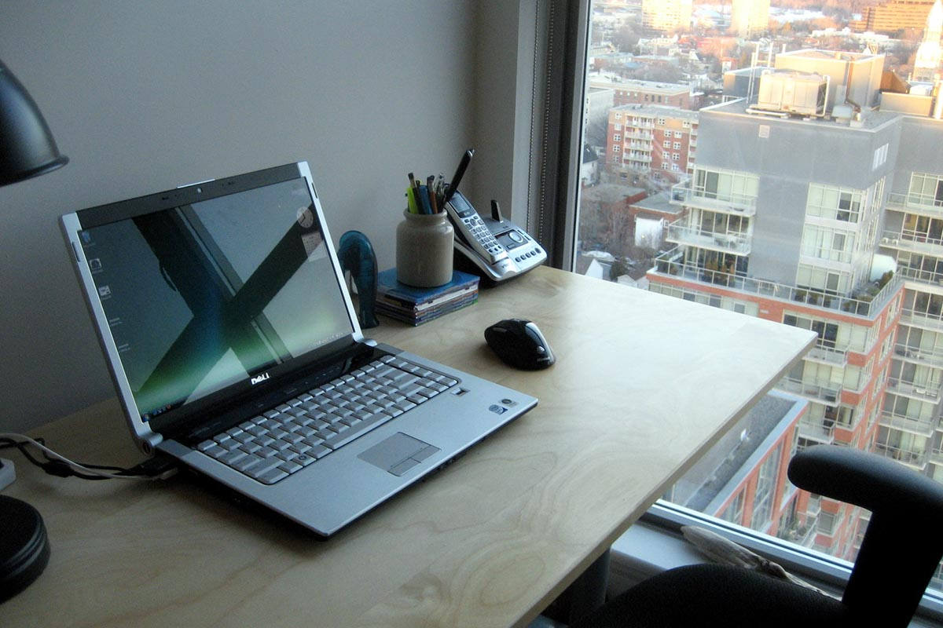
THANK YOU
HAVE A NICE DAY
THANK YOU
HAVE A NICE DAY

